Slide 1
Voting Machine Application
Savitribai Phule Pune University ,Pune
(Formerly University of Pune)
Department of Mathematics
M.Sc.(Industrial Mathematics With Computer Application)-I
Project Name:-
Guide By :-
Dr. Smita A Kandekar Mam
Representation By :-
Abhay V Gadge
Pratik S Barhate
Rakesh B Shirsath

Slide 2
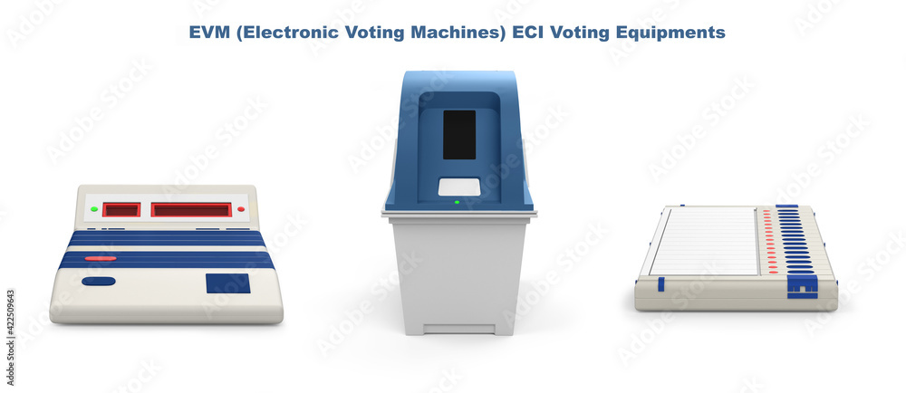
Welcome to Voting Calculate Machine System Application

Slide 3
Content
1. Introduction
2.History Of Indian Voting System
3.Objective
4.Data Flow Diagram
5.Voting System Project C++ Program Code
6.Program Output
7.Conclusion
8.References

Slide 4
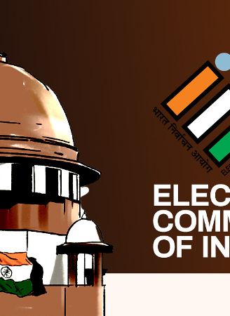
Introduction
The Electronic Voting Machine was proposed in 1977 and Electronics Corporation of India (ECIL)
In 1979, a working model was evolved and was showcased to various political parties on 6 August 1980.[
Bharat Electronics (BEL) and ECIL were tasked with manufacturing EVMs.
The EVMs were first trialed in 1982 in the by-election to Paravur assembly constituency in Kerala in a limited number of polling stations.

Slide 5
Indian History Of Voting
In the first two elections, separate ballot boxes with each candidate's name and symbol were set up in the polling booth.
Voters had to put their blank ballot paper in the box for the candidate they wanted to support.
After the second election, voting began with each voter using a ballot paper that contained the candidates' names and symbols.
Each voter had to deposit the ballot paper in a common ballot box.
The Electronic Voting Machine was used in Kerala for the first time in India in 1982.
In 2003, all state elections were conducted using EVMs.
This encouraged the ECI to use EVMs for the 2004 Lok Sabha elections.
Electronic Voting Machines allow voters to vote by pressing a button next to the name or image of the candidate they want to support.

Slide 6
Old Methods Of VOTING
1.Paper-Based Voting
2.Lever Voting Machine
3.Direct Recording Electronic Voting Machine
4.Punch Card
5.Optical Voting Machine

Slide 7
Introduction To online voting system
1.”Online Voting System “ is an online voting technique . In this system people who are citizens and whose age is above 18 years of age. any sex can give his/her vote online without going to any physical polling station.
2.In “Online Voting System” a voter can use his\her voting right online without any difficulty. He/She has to be registered first for him\her to vote manually . Registration is mainly done by the system administrator for security reasons.
3.After registration, the voter is assigned a secret Login ID and password with which he/she can to log into the system and enjoy services provided by the system such as voting. If invalid/wrong details are submitted , then the citizen is not registered to vote.

Slide 8
SIGNFICANCE(purpose) OF OVS
Provision of improved voting services to the voters through fast, timely and convenient voting.
Reduction of the costs incurred by the Electoral Authority during voting time in paying the very many employed for the sake of the success of the manual system.
Check to ensure that the members who are registered are the only ones to vote. Cases of “Dead People” voting are also minimized.
Online voting system (OVS) will require being very precise or cost cutting to produce an effective election management system.
Increased number of voters as individual as individual will find it easier and more convenient to vote, especially those abroad.

Slide 9

Objective
Reviewing the existing/Current voting process:
Coming up with an automated voting system.
Implementing a an automated /online voting system.
Validating the system to ensure that only legible voters are allowed to vote.

Slide 10
Data Flow Diagram Of Voting Machine app
AAP
BSP
Voting
Machine
App
voter
Party
congress
BJP

Slide 11

VOTING MACHINE C++ Program Code
Program Code start from Here By Include iostream header file of C++ language.
#include<iostream>
using namespace std;
int bjp=0, congress=0, aap=0, bsp=0;

Slide 12
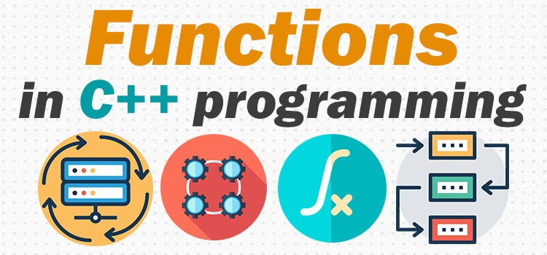
//Function declare of it definition
void electionResult()
{
int wonByvote;
if(bjp>congress&&bjp>aap&&bjp>bsp)
{
cout<<"\n********************************************";
cout<<"\n BJP won the election \n"<<endl;
cout<<" Total vote of BJP :"<<bjp<<endl;
wonByvote=bjp-congress;
cout<<"\n BJP won by "<<wonByvote<<" votes to congress"<<endl;
wonByvote=bjp-aap;
cout<<" BJP won by "<<wonByvote<<" votes to AAP"<<endl;
wonByvote=bjp-bsp;
cout<<" BJP won by "<<wonByvote<<" votes to BSP"<<endl;
cout<<"**********************************************\n";
}

Slide 13
}
else if(congress>aap&&congress>bsp)
{
cout<<"\n********************************************";
cout<<"\n Congress won the Election \n\n";
cout<<"\n Total vote of Congress :"<<congress<<endl;
wonByvote=congress-bjp;
cout<<" Congress won by "<<wonByvote<<" vote to BJP\n"<<endl;
wonByvote=congress-aap;
cout<<" Congress won by "<<wonByvote<<" vote to AAP\n"<<endl;
wonByvote=congress-bsp;
cout<<" Congress won by "<<wonByvote<<" vote to BSP\n"<<endl;
cout<<"**********************************************\n";
}

Slide 14
else if(aap>bsp)
{
cout<<"\n********************************************";
cout<<"\n AAP won Election \n\n";
cout<<" Total vote of AAP :"<<aap<<endl;
wonByvote=aap-congress;
cout<<"\n AAP won by "<<wonByvote<<" vote to Congress\n"<<endl;
wonByvote=aap-bjp;
cout<<"\n AAP won by "<<wonByvote<<" vote to BJP\n"<<endl;
wonByvote=aap-bsp;
cout<<"\n AAP won by "<<wonByvote<<" vote to BSP\n"<<endl;
cout<<"**********************************************\n";
}

Slide 15
else if(bsp==congress&&bjp==aap&&bjp==bsp)
{
cout<<"\n********************************************";
cout<<"\n Every party got equal votes\n\n";
cout<<"party\t\tVotes\n";
cout<<"BJP\t\t "<<bjp<<endl;
cout<<"Congress \t "<<congress<<endl;
cout<<"AAP\t\t "<<aap<<endl;
cout<<"BSP\t\t "<<bsp<<endl;
cout<<"**********************************************\n";
}

Slide 16
else
{
cout<<"\n********************************************";
cout<<"\n BSP won the Election \n\n";
cout<<" Total vote of BSP :"<<bsp<<endl;
wonByvote=bsp-congress;
cout<<"\n BSP won by "<<wonByvote<<" votes to Congress\n";
wonByvote=bsp-aap;
cout<<"\n BSP won by "<<wonByvote<<" vote to AAP\n";
wonByvote=bsp-bjp;
cout<<"\n BSP won by "<<wonByvote<<" vote to BJP\n";
cout<<"**********************************************\n";
}
}

Slide 17
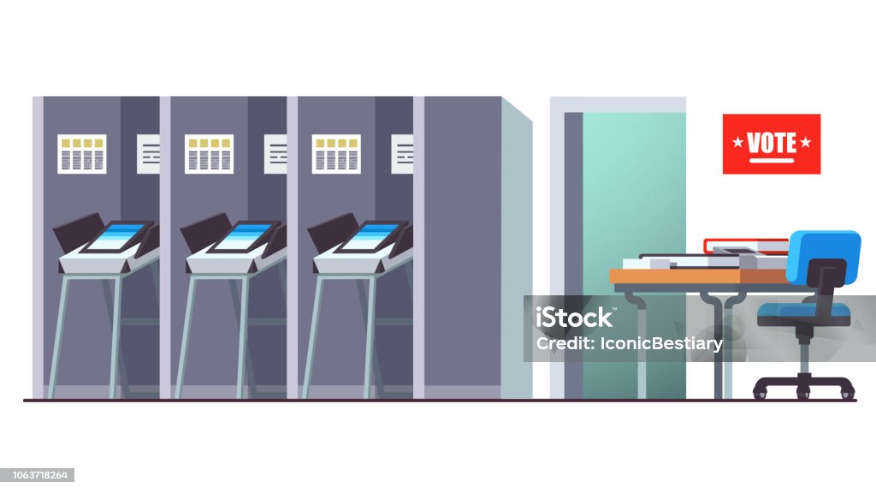
void calculatevote(int vote)
{
switch(vote)
{
case 1:
bjp+=1;
break;
case 2:
congress+=1;
break;
case 3:
aap+=1;
break;
case 4:
bsp+=1;
break;
}
}

Slide 18
int main()
{
int choose;
cout<<"\n WELCOME TO SIMPLE VOTING SYSTEM PROJECT \n\n";
cout<<" LOKSABHA ELECTION \n\n";
cout<<"***********************************************************************\n";
cout<<"| 1.BJP | 2.Congress |\n";
cout<<"***********************************************************************\n";
cout<<"| 3.APP | 4.BSP |\n";
cout<<"***********************************************************************\n";
cout<<" Press 1 to vote BJP \n";
cout<<" Press 2 to vote Congress \n";
cout<<" Press 3 to vote AAP \n ";
cout<<" Press 4 to vote BSP \n";
cout<<" Press 5 to show election Result\n\n";

Slide 19
do
{
cout<<"Give vote By Pressing Digit : ";
cin>>choose;
if(choose==5)
{
electionResult();
}
else if(choose >=1&&choose<5)
{
calculatevote(choose);
}
else
{
cout<<"\nInvalid key pressed try again"<<endl;
}
}while(choose != 5);
cout<<endl;
return 0;
}

Slide 20
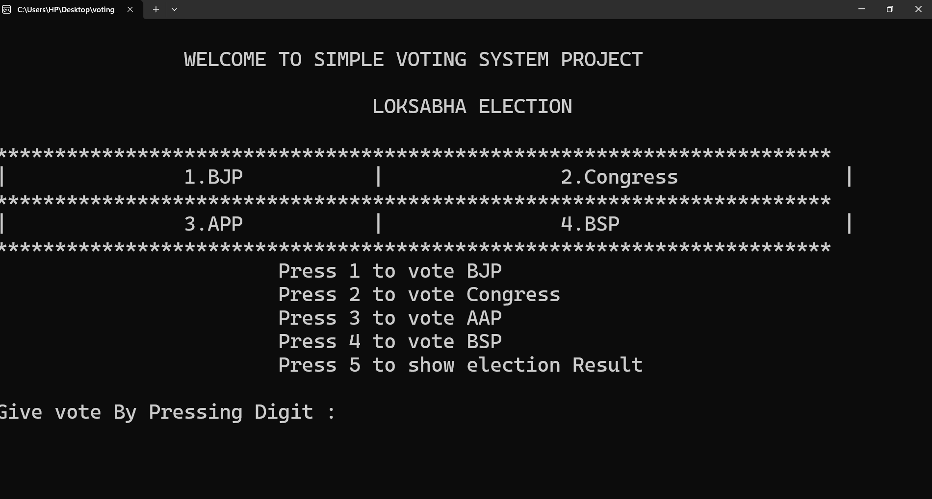
Program Output:-

Slide 21
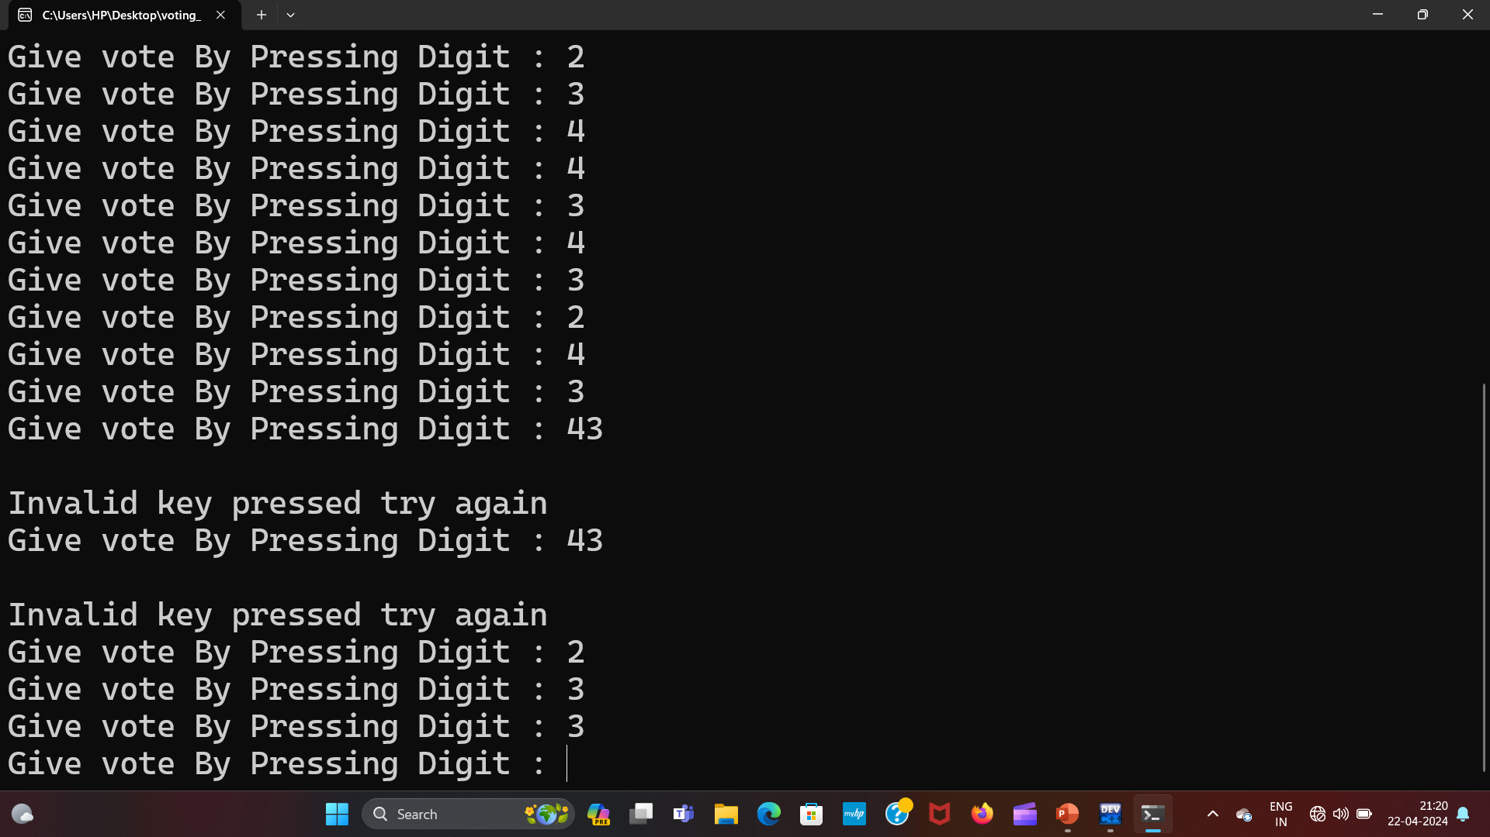

Slide 22
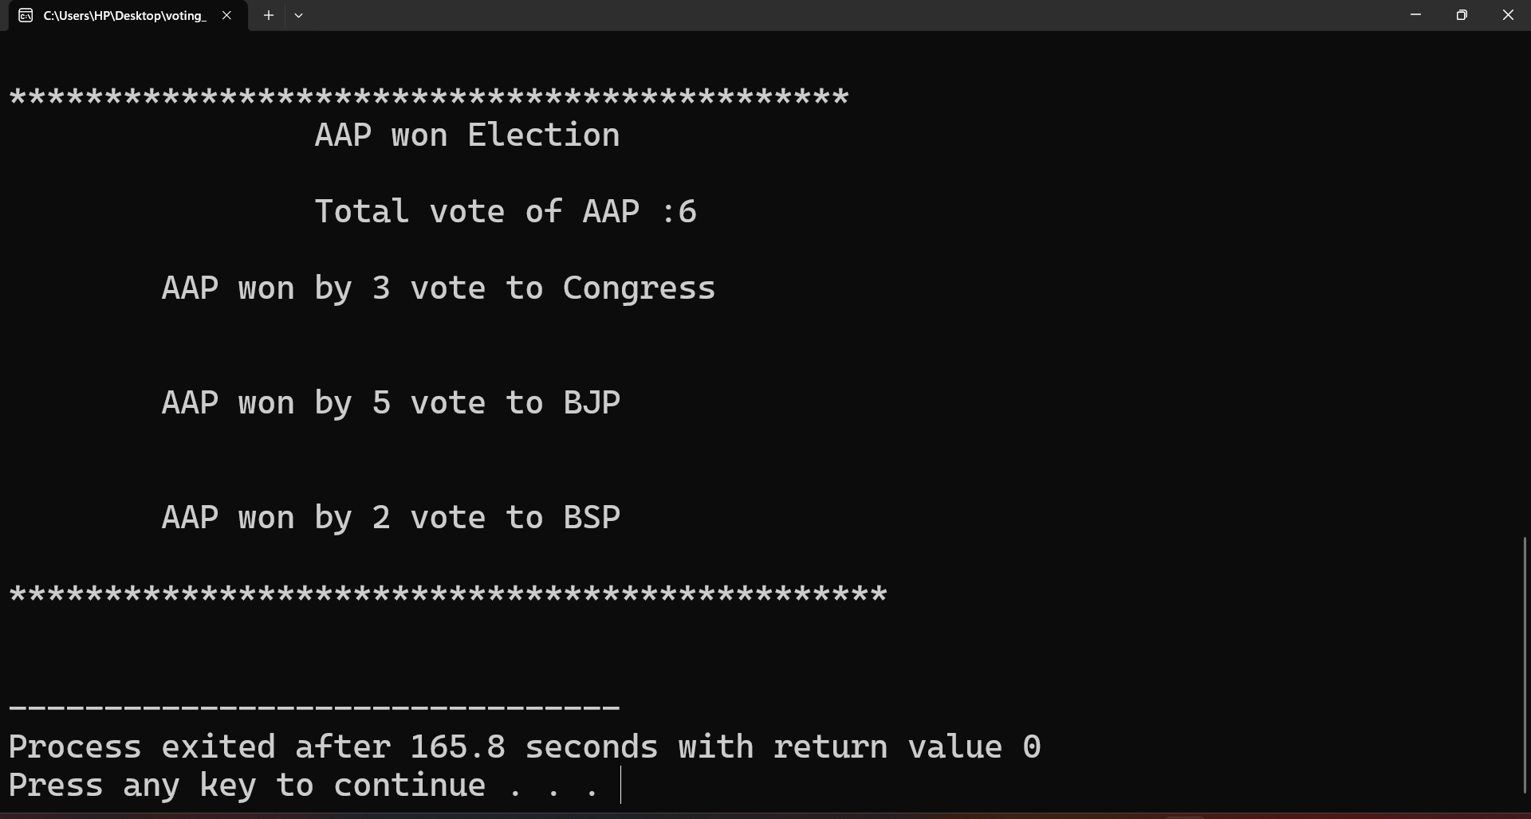

Slide 23
Advantage
It has higher level of security as it has two stage authentication technique i.e., Facial recognition and One Time Password(OTP).
Voter data that is his facial images and voter id will be stored on the database.
Verification process done by server itself.
Voter is allowed to cast his vote after successful verification with facial recognition and One Time Password.

Slide 24
Conclusion
Online Voting Systems have many advantage over the traditional voting system.
Some of these advantage are less cost, faster generation results, easy accessibility, accuracy, and low risk of human and mechanical errors.
It is very difficult to develop online voting system which can allow security and privacy on the high level.
Future development focused to design a system a system which can allow security and privacy on the high level.
Future development focused to design a system which can be easy to use and will provide security and privacy of votes on acceptable level by proper authentication and processing section.
It is easy to use and it is less time consuming.
It is very easy to debug.

Slide 25
References
Youtube:- ://youtu.be/E8X39OyNE6A?si=MTG5fbbeD310RXo-
Google:-https://www.slideshare.net/slideshow/voting-project-mini-project-pdf/261385591

Slide 26
Any
Question ?

Slide 27
Thank you

